Slide 1
Professional Issues in IT
Topic 10:
Analysing and Applying IT Service Management
Notes:
NCC Education - Title Master

Slide 2
Scope and Coverage
This topic will cover:
  ITSM International Standard
  ITSM frameworks
Notes:
NCC Education - Slide Master

Slide 3
Learning Outcomes
By the end of this topic students will be able to:
  Identify and describe international ITSM standard;
  Identify and describe ITSM frameworks;
  Show developed practical ITSM skills.

Slide 4
ITSM Standard and Frameworks
International Standard
    ISO 20000
Frameworks
    ITIL
    COBIT
    ITSM

Slide 5
ISO 20000 - 1
First international service management standard
Replaced UK BS15000
Launched December 2005
Published by International Organisation for Standardisation (ISO)
Aim
    Proactive approach to IT service management

Slide 6
ISO 20000 - 2
Enables organisations to accredit to global standard
    Audit certification process
    Annual retention audits
Demonstrates organisation knowledge/ability
    Management practices, procedures and controls
    Potential competitive advantage
Becoming required standard for Government IT contract bidders
    UK National Health Service
    US Air Force
      http://tinyurl.com/4yclknx

Slide 7
ISO 20000 - 3
Written to align with ITIL best practice
ITSM frameworks compatible
    COBIT
5 part international standard
    20000-1 certifiable standard
    20000-2 code of practice
    20000-3 scope definition and applicability guidance
    20000-4 process reference model
    20000-5 exemplar implementation plan

Slide 8
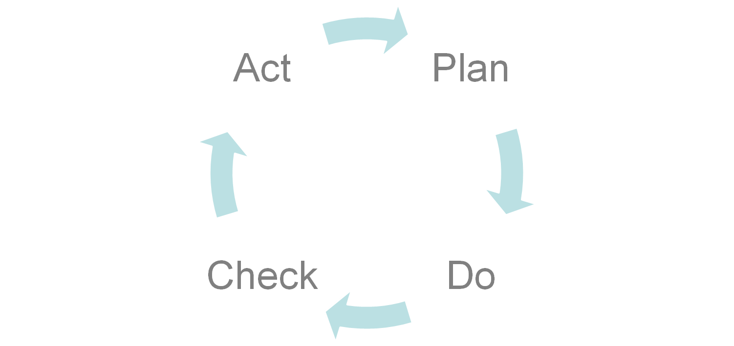
Plan-Do-Check-Act (PDCA)

Slide 9
ISO 20000 Part 1
Formal specification
    2011 version
Defines organisation requirements
    Managed services quality
Integrated management processes
    Deliver effective services
Includes
    Plan-do-check-act ISO operating principle

Slide 10
ISO 20000 Part 2
Series of best practices:
    Based on ISO 20000 Part 1
    Industry based guidance
    Ideal stepping stone for part 1 auditing

Slide 11
Information Technology International Library (ITIL) - 1
Published by Office of Government Commerce (OGC)
    UK government department
Pre-dates ISO 20000
Created in consultation with public and private sectors
Cohesive best practice framework
Series of ITSM concepts and practices
    Checklists and procedures

Slide 12
ITIL - 2
ITIL aligned with ISO 20000
    OGC vowed to continue alignment
Version 3 launch 2007
Benefits
    Focused on customer benefit and efficiency
    Increased business relevance
    Increase IT service value
    Pro-active approach culture
Issues
    Not a formal standard

Slide 13
ITIL - 3
Standardised SLA and contract materials
SLS template
ITIL lifecycle
    Service strategy
    Service design
    Service transition
    Service operation
    Continual service improvement

Slide 14
ITIL Lifecycle
You can view a complete visual overview of ITIL lifecycle phases at www.itil.org

Slide 15
COBIT
Control OBjectives for Information and related Technology
Developed by Information Systems Audit and Control Association (ISACA)
Concerned with IT governance of ITSM
    No tolerance of misconduct
Best practise framework
    Provides IT process controls
    Provides audit and compliance guidance

Slide 16
ITSM 2.0 - 1
Traditional and cloud combined framework
    For cloud environment
Launched 2011
Aim
    Alter approach to current and next generation service management
    “ITSM 2.0 represents a key milestone in moving to cloud based services…”
    (Paul Speers, MD of FoxIT in Bean, S: 2011)

Slide 17
ITSM 2.0 - 2
ITIL/COBIT compatible
Developed by SM organisation
    ITIL/COBIT developed by institutes
Organisation focused
Strengthen best practice and current standards
Use current best practice as ITSM 2.0 foundation

Slide 18
References - 1
  Bean, S. (2011). Fox IT launches ITSM 2.0 the next generation of IT Service Management. [Available Online] www.sourcewire.com/releases/rel_display.php?relid=64369
  Brooks, P. (2006). Metrics for IT Service Management. Van Haren.
  Reynolds, G. (2010). Information Technology for Managers. Course Technology Cengage Learning.

Slide 19
References - 2
  apmg-international.com
  www.bcs.org
  www.iso.org
  www.itgovernance.co.uk
  www.itsm.info
  www.itsmfi.org
  ww.itsmportal.com

Slide 20
Topic 10 – Analysing and Applying IT Service Management
Any Questions?
Notes:
NCC Education - End Slide Master

